Slide 1
Chapter 8:
Computer
Reliability

Slide 2
Chapter Overview
Introduction
Data entry or data retrieval errors
Software and billing errors
Notable software system failures
Therac-25
Computer simulations
Software engineering
Software warranties and vendor liability
1-<number>

Slide 3
8.1 Introduction
Computer systems are sometimes unreliable
  Erroneous information in databases
  Misinterpretation of database information
  Malfunction of embedded systems
Effects of computer errors
  Inconvenience
  Bad business decisions
  Fatalities
1-<number>

Slide 4
8.2 Data-Entry or Data-Retrieval
Errors
1-<number>

Slide 5
Two Kinds of Data-related Failure
A computerized system may fail because wrong data entered into it
A computerized system may fail because people incorrectly interpret data they retrieve
1-<number>

Slide 6
Disfranchised Voters
November 2000 general election
Florida disqualified thousands of voters
Reason: People identified as felons
Cause: Incorrect records in voter database
Consequence: May have affected election’s outcome
1-<number>

Slide 7
False Arrests
Sheila Jackson Stossier mistaken for Shirley Jackson
  Arrested and spent five days in detention
Roberto Hernandez mistaken for another Roberto Hernandez
  Arrested twice and spent 12 days in jail
Terry Dean Rogan arrested after someone stole his identity
  Arrested five times, three times at gun point
1-<number>

Slide 8
Accuracy of NCIC Records
March 2003: Justice Dept. announces FBI not responsible for accuracy of NCIC information
Exempts NCIC from some provisions of Privacy Act of 1974
Should government take responsibility for data correctness?
1-<number>

Slide 9
Dept. of Justice Position
Impractical for FBI to be responsible for data’s accuracy
Much information provided by other law enforcement and intelligence agencies
Agents should be able to use discretion
If provisions of Privacy Act strictly followed, much less information would be in NCIC
Result: fewer arrests
1-<number>

Slide 10
Position of Privacy Advocates
Number of records is increasing
More erroneous records → more false arrests
Accuracy of NCIC records more important than ever
1-<number>

Slide 11
Act Utilitarian Analysis:
Database of Stolen Vehicles
Over 1 million cars stolen every year
Just over half are recovered, say 500,000
Assume NCIC is responsible for at least 20%
100,000 cars recovered because of NCIC
Benefit of $5,000 per car (owner gets car back; effects on national insurance rates; criminal doesn’t profit)
Total value of NCIC stolen vehicle database: $500,000/year
Only a few stories of false arrests
Assume 1 false arrest per year (probably high)
Assume harm caused by false arrest $55,000 (size of award to Rogan)
Benefit surpasses harm by $445,000/year
Conclusion: Good to have NCIC stolen vehicles database
1-<number>

Slide 12
8.3 Software and Billing Errors
1-<number>

Slide 13
Errors When Data Are Correct
Assume data correctly fed into computerized system
System may still fail if there is an error in its programming
1-<number>

Slide 14
Errors Leading to System Malfunctions
Qwest sent incorrect bills to cell phone customers
Faulty USDA beef price reports
U.S. Postal Service returned mail addressed to Patent and Trademark Office
Spelling and grammar error checkers increased errors
New York City Housing authority overcharged renters
About 450 California prison inmates mistakenly released
1-<number>

Slide 15
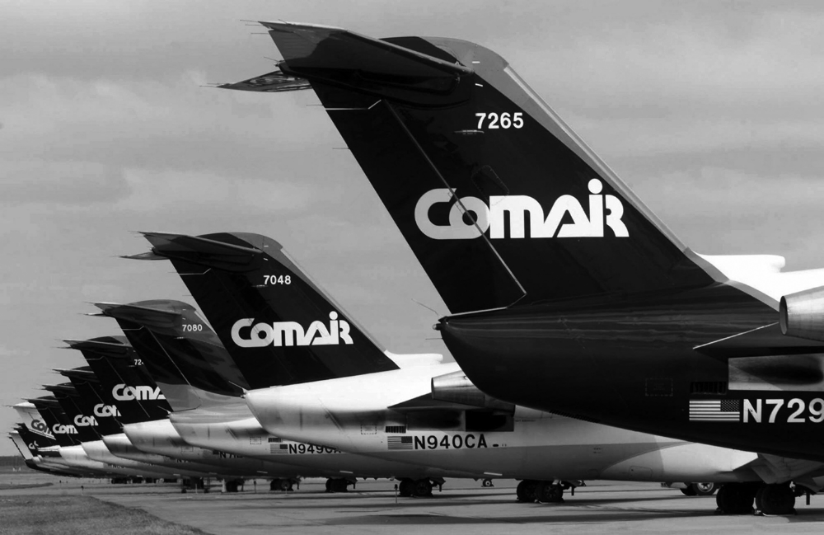
Comair Cancelled All Flights on Christmas Day, 2004
AP Photo/Al Behrman, File
1-<number>

